Slide 1
MCM Problem B
Jessica, Eleanore, Bob

Slide 2
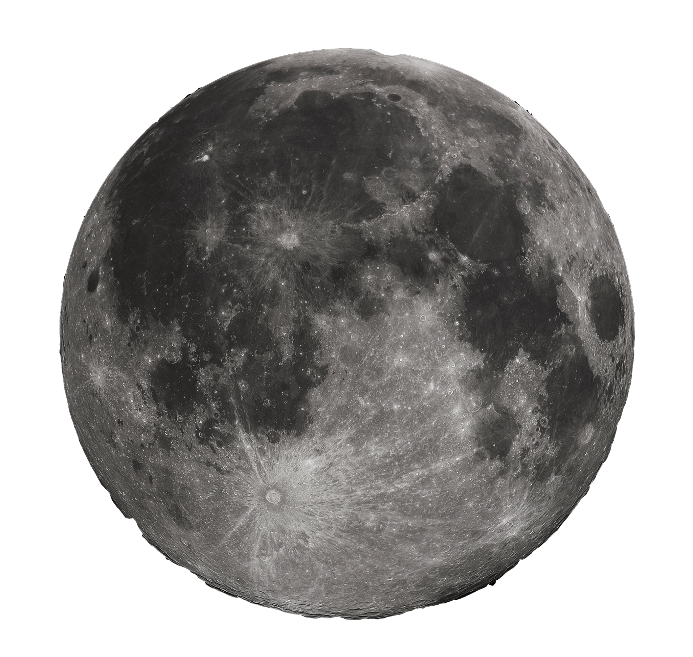
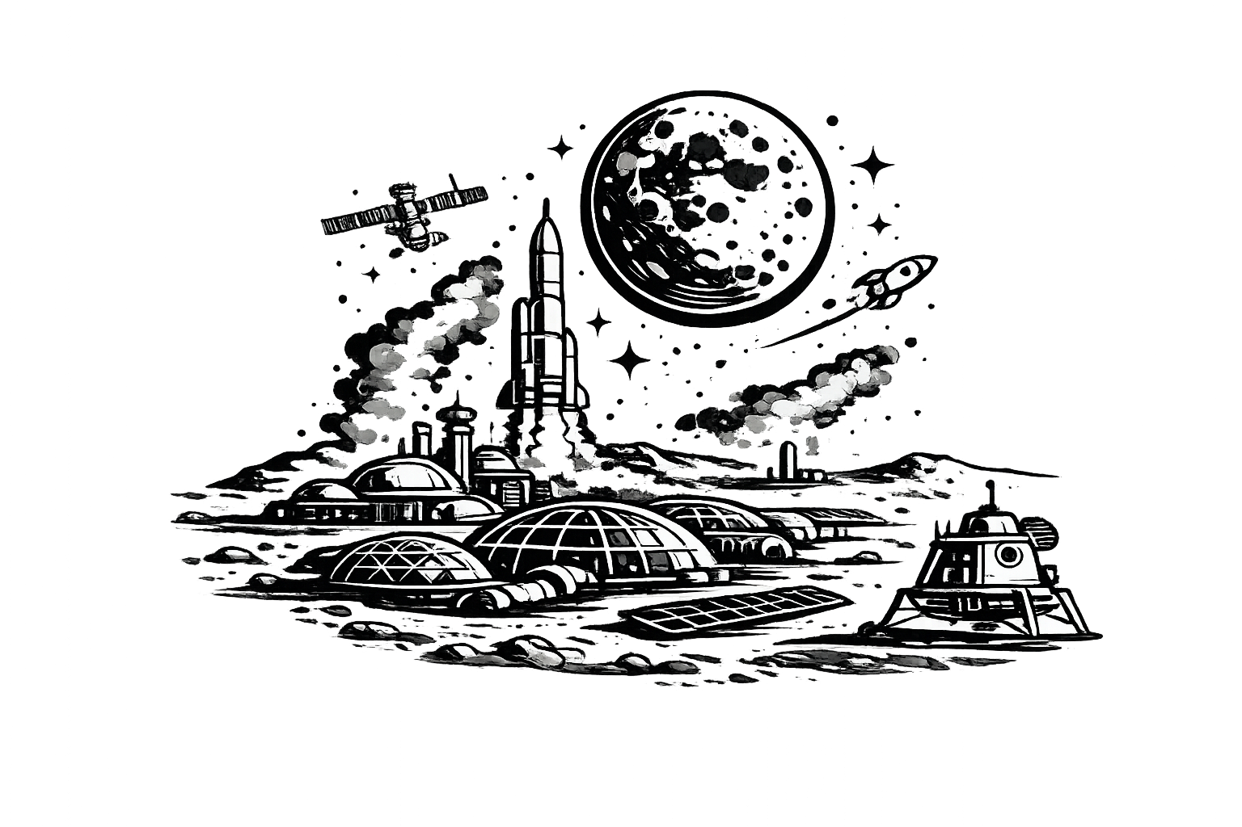


Context
100 million metric tons of material needed
*nothing is to scale; only strictly interpret it as an infographic
Rocket Launches from only available 10 interplanetary sites
100,000 people Moon Colony
Falcon Heavy
Apex
Each year x amount of water needed to sustain the colony
3 * 10,000km Space Elevators on Equator
Question: Determine an optimal strategy (rocket-only, elevator-only, or hybrid) that balances cost, timeline, and environmental impact, while maintaining resilience against system failures.

Slide 3

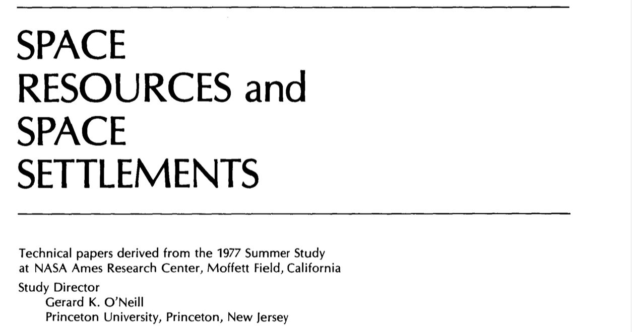
Related Literature
ISEC (Decade-long paper)
International Space Elevator Consortium
Established basic guidelines for where to construct space elevators and delivery process
Confirmed tether material and expected full operational capacity (79 tons) [1]
Acknowledged that Space Elevators are completely green and we can release nuclear wastes into space
Space Elevator Mechanism
Investigated for a specific tether material (carbon nanotube) whether swaying is a concern
NASA’s reports on Moon Colony [10]
1977 Studies on Various topics related to moon settlement, including designs and sustainability analysis of (suggested 10,000 people) Moon Colony, local extraction/mining processes for metals and oxygen, etc.
NASA’s study on Biomass Production in Extreme Circumstances [8]
Can achieve 20 g/m^2/day production and high water recovery rate through condensed evapotranspiration

Slide 4
Assumptions and Justifications
1. Assumption: From 2050 onward, logistics capacities KE and KR remain constant over time, except when interrupted by modeled stochastic failures.
Justification: This allows us to focus on long-run capacity constraints without introducing speculative technology ramp-up or degradation dynamics.
2. Assumption: Unit transport costs are linear and time-invariant, and all costs are measured in constant dollars (no economies of scale, inflation, or discounting). Justification: This isolates the cost–time tradeoff implied by physical constraints and avoids introducing uncertain macroeconomic assumptions.
3. Assumption: Atmospheric and orbital conditions are constant, and launch sites are always available unless a stochastic "failure event" is triggered. Justification: The century-long scale of the project means short-term local delays average out. Major system disruptions can be handled through our Monte Carlo simulation.
4. Assumption: The average ∆v required for lunar transit is a constant 15 km/s. Justification: This follows the Hohmann transfer orbit principles. It allows us to better account for the Earth’s rotational assist at the Apex Anchor and compares the latitudinal ∆v difference at different launch sites.

Slide 5
Assumptions and Justifications
4. Assumption: The average ∆v required for lunar transit is a constant 15 km/s. Justification: This follows the Hohmann transfer orbit principles. It allows us to better account for the Earth’s rotational assist at the Apex Anchor and compares the latitudinal ∆v difference at different launch sites.
5. Assumption: The fuel-to-payload efficiency ratio at the Apex Anchor is identical to that on the Earth’s surface. Justification: This allows us to apply the cost coefficient C∆v,1 across all three logistic plans, providing a more efficient estimation.
6. Assumption: The lunar colony operates as a near-closed-loop regenerative system with high water recovery rates and agricultural productivity. Justification: High efficiency in production and recycling is a prerequisite for a moon colony of 100,000 people. These figures align with NASA’s Biomass Production Chamber (BPC) benchmarks and current ISS life-support performance.
7. Assumption: By 2050, the fuel efficiency of going to the Moon is the same as that of reaching LEO at present. Justification: This assumption is based on the logarithmic maturity of aerospace technologies. Historically, the cost and energy efficiency of new frontiers stabilize after three decades of commercialization.

Slide 6
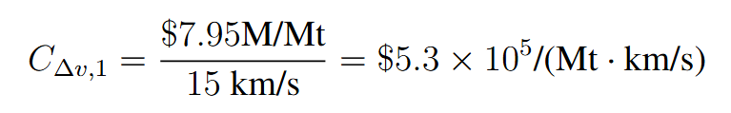
Delivery Scenarios
Scenario A. Only Rockets
10⁸ metric tons of materials
Falcon Heavy delivery capacity: 100 metric tons per launch
Assuming 1 launch from each launch site each day 10⁸ / 100 / (10*365) ~ 274 years
Assuming rocket cost breakup as follow
Assuming a 35% booster loss rate, ~ $795 million/launch.
Cost using rocket = $7.95M/Mt. For 10⁸ Mt, this is a total of $795 trillion.
(For future use) assuming Earth-to-Moon ∆v = 15 km/s, the cost to provide 1 Mt with 1 km/s of ∆v:
Manufacture Cost | $100M/rocket | The cost of producing one rocket. If the booster is recovered and the rocket can be reused, this cost is saved.
Operational Cost | $60M/launch | The fixed logistic and personnel cost of each launch.
Cargo Cost | $7000/kg | The cost of delivering 1 kg of cargo. Estimated according to Falcon Heavy.
We assume that this value is the same for launching from Apex Anchor and from Earth’s equator.

Slide 7
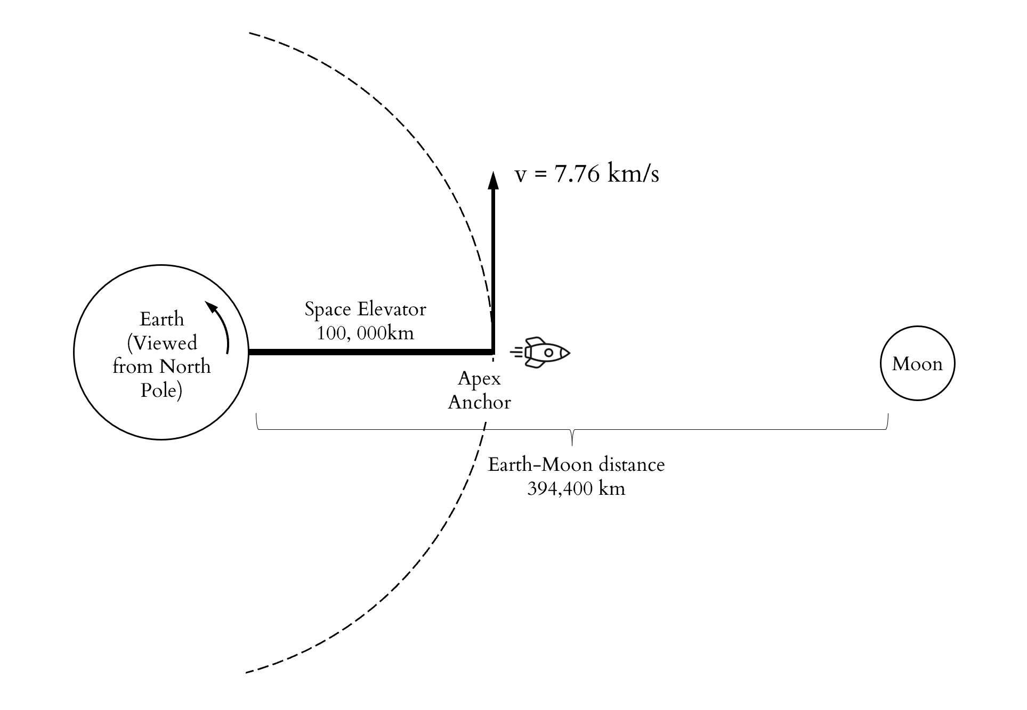


Delivery Scenarios
Scenario B. Only Space Elevator
10⁸ metric tons of material
Each of the 3 galactic harbor has a capacity of 179,000 tons/yr
Takes ~ 186 years to deliver
Elevator Cost from Earth to Apex Anchor
Work needed to lift 1kg from Earth’s surface at the equator to the Apex Anchor:
~ 2.88⁷ ×10 J/kg = 8.00 × 10³ kWh/Mt
Assuming electricity efficiency and price
Cost/tons = $1.88*10^3 M/Mt
For total 537,000 Mt/yr, total cost is $1.01 * 10⁹ yr * 186 yr ~ $188 billion

Slide 8


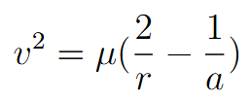
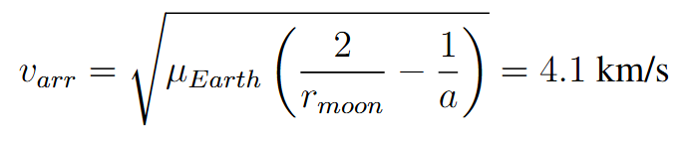
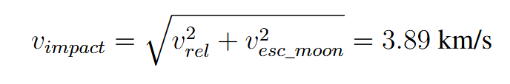
Delivery Scenarios
Scenario B. Only Space Elevator
(b) Launching Cost from Apex to Moon
Tangential speed at apex anchor:
Vis Visa Equation
gives a = -27000 km < 0
v > escape trajectory: the cargo will fly away from the moon into outer space if released directly
Arrival velocity at moon’s orbital radius
Moon’s orbital rotational velocity: 1.02 km/s → Relative velocity: 3.08 km/s
Moon escape velocity: 2.38 km/s
This is our ∆v (which is actually negative because the rocket is slowing the cargo down!)
(this comes from orbital energy conservation)

Slide 9
Delivery Scenarios
Scenario B. Only Space Elevator
(b) Launching Cost from Apex to Moon
Apply the :
For 10^8 Mt, the total cost is $210 trillion.
Cost of part (a) and (b) together: $210.188 trillion

Slide 10
Delivery Scenarios
Scenario C. Hybrid
Impossible to determine scheduling in a century-long project, we divide into 2 parts:
Treat volumes and launch capacities as continuous variables. Solve a LP for each candidate completion time T, and minimize cost while meeting the delivery goal. This traces the Pareto-optimal time-cost curve.
With a monthly goal, consider each day the binary choice to launch a rocket and to use how many climbers.

Slide 11
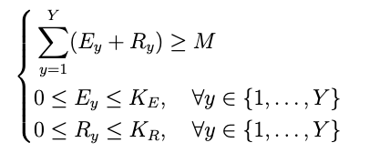
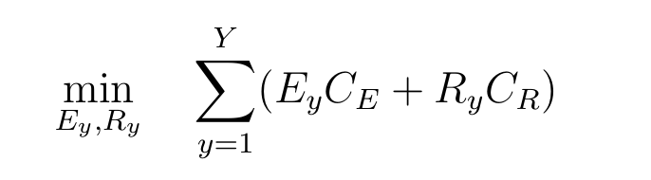
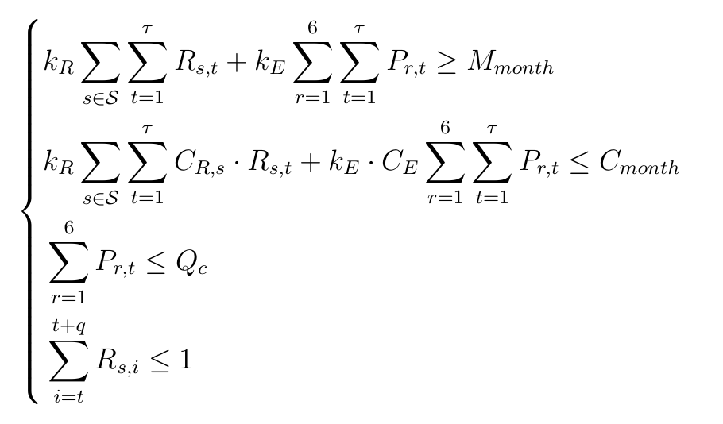





Delivery Scenarios
Scenario C. Hybrid
varies by site because there’s a geometric misalignment between launch site and Moon’s orbital plane

Slide 12
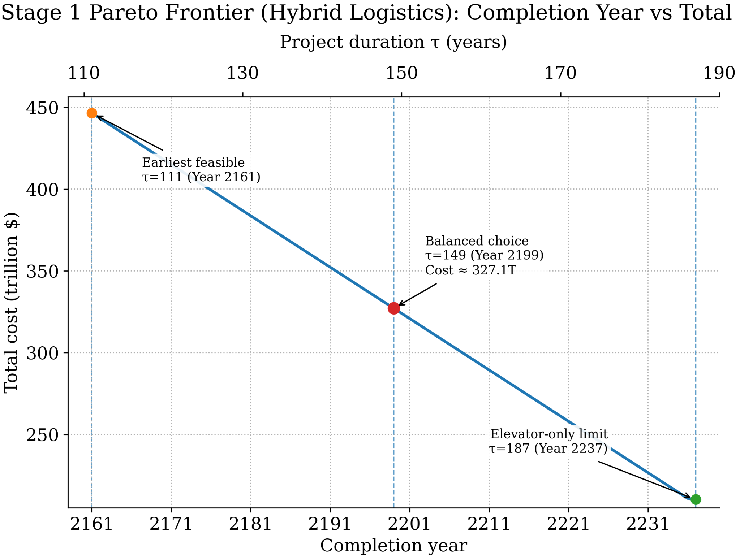
Delivery Scenarios
Scenario C. Hybrid
OPTIMIZATION TRADEOFF BOB

Slide 13
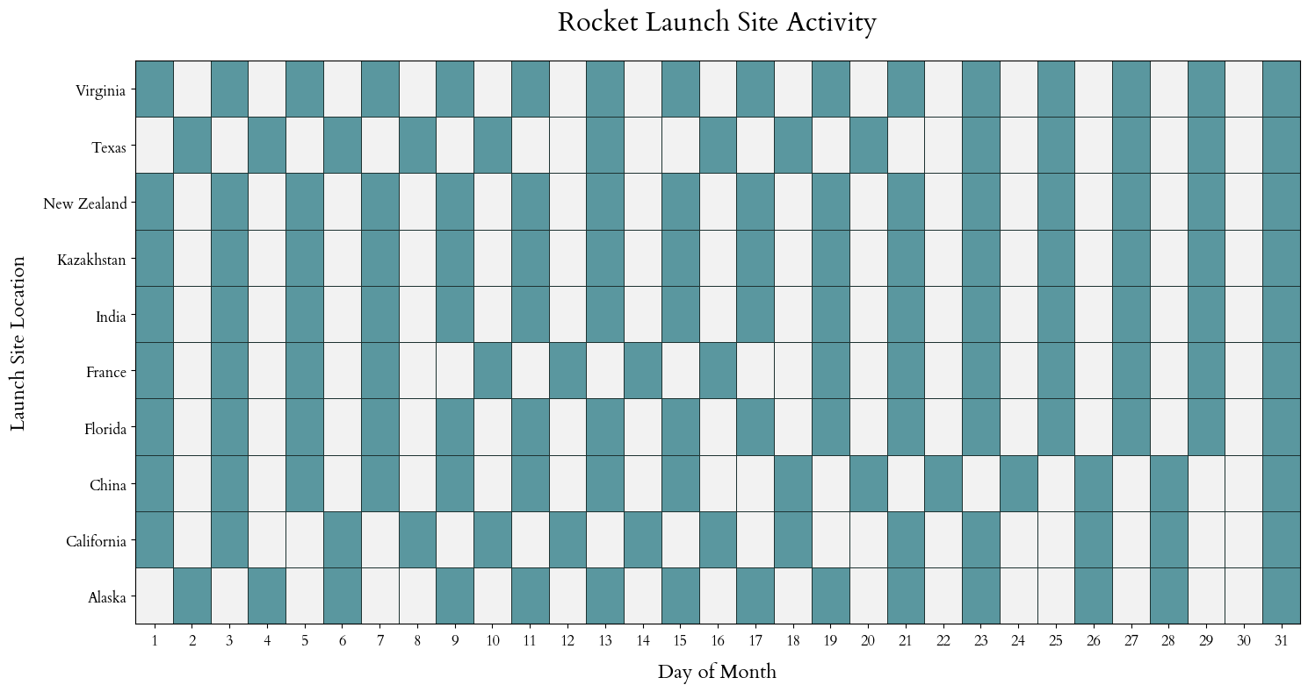
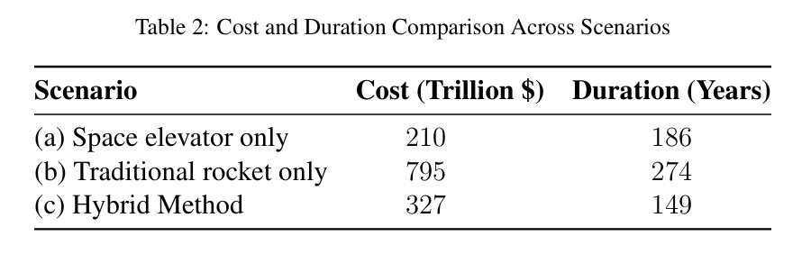
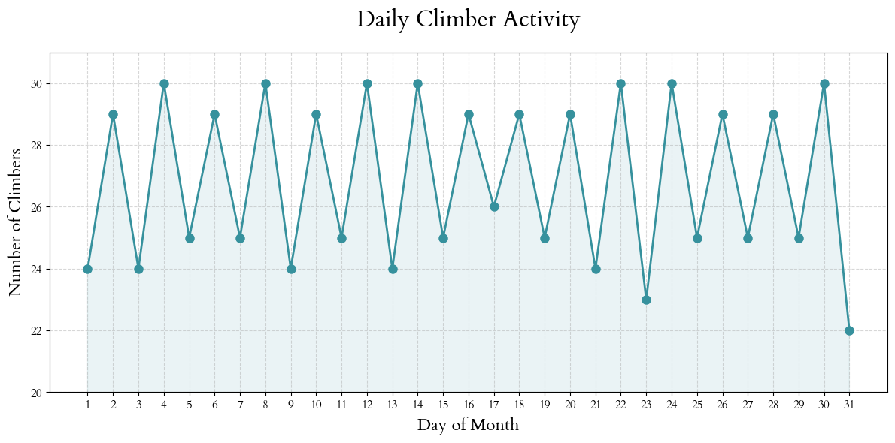
Delivery Scenarios
Results

Slide 14


Stochastic Disruptions
Tether Swaying
Induced by Coriolis forces on the ascending climbers
Modeled with undamped harmonic oscillation by Cohen & Misra paper
Residual oscillation angular amplitude after one climber arrives at Apex Anchor:
We assume that our space elevator tether uses carbon nanotube, same as Cohen & Misra, with natural oscillation period of 5 days → α ~ 1mRad.
For tether to return to vertical equilibrium after a sequence of p climbers arrives, the climbers must be separated by an interval of
where i is index of individual climbers, n is number of oscillatory cycles to wait for, n = 0, 1, 2...

Slide 15
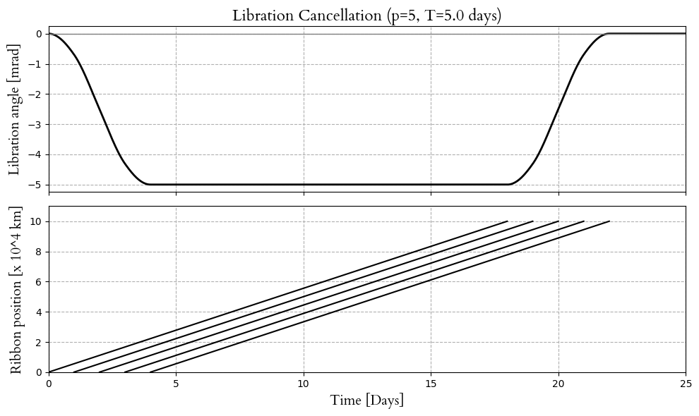
Stochastic Disruptions
Tether Swaying
T = 5 days, n = 0, p = 5

Slide 16
Stochastic Disruptions
Failures
We assume:
Each rocket launch fails independently with probability p_{R} = 2%. (2025-level). Failed launch has full cost but payload 0.
Each elevator climber fails independently with probability pE = 0.0001% =
10⁻⁶. If a failure occurs, the elevator shuts down for 30 days, and a repair cost of $5 billion is incurred.
The elevator requires a maintenance cost of $85 million per year.

Slide 17
Stochastic Disruptions
Failures
BOB ANALYSIS!!!

Slide 18
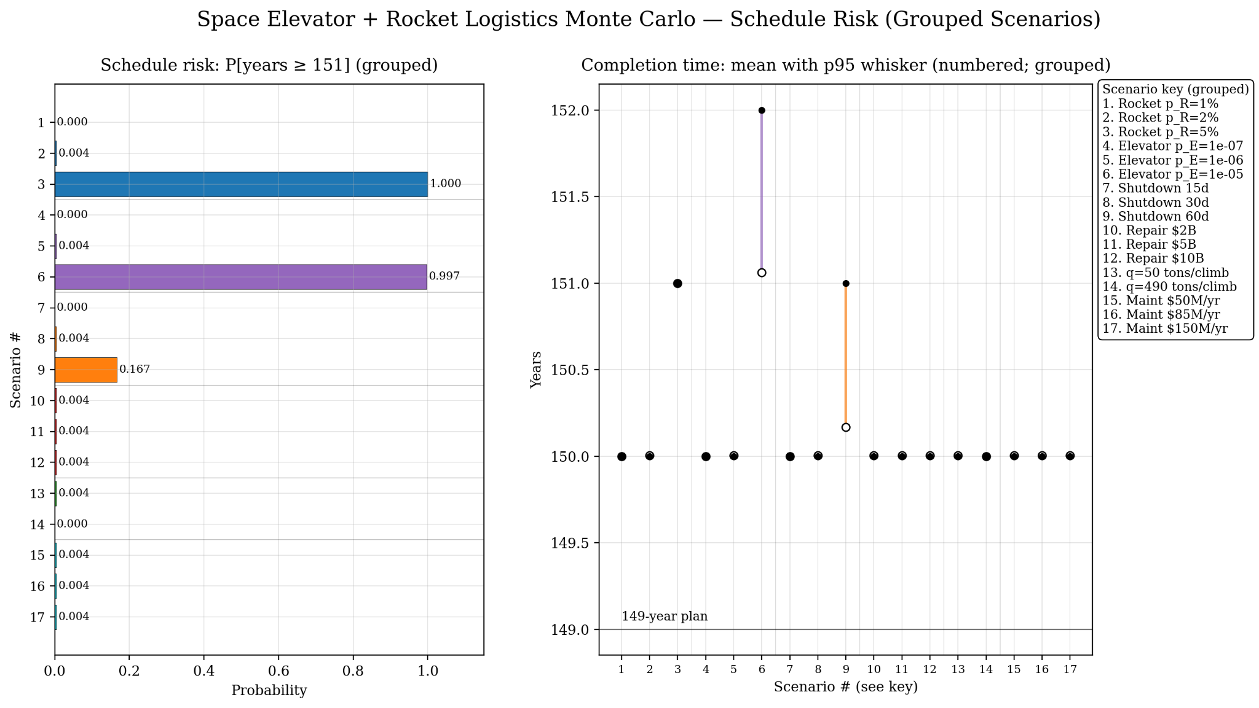
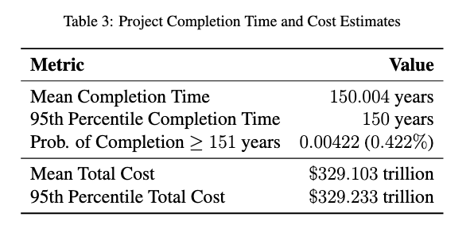
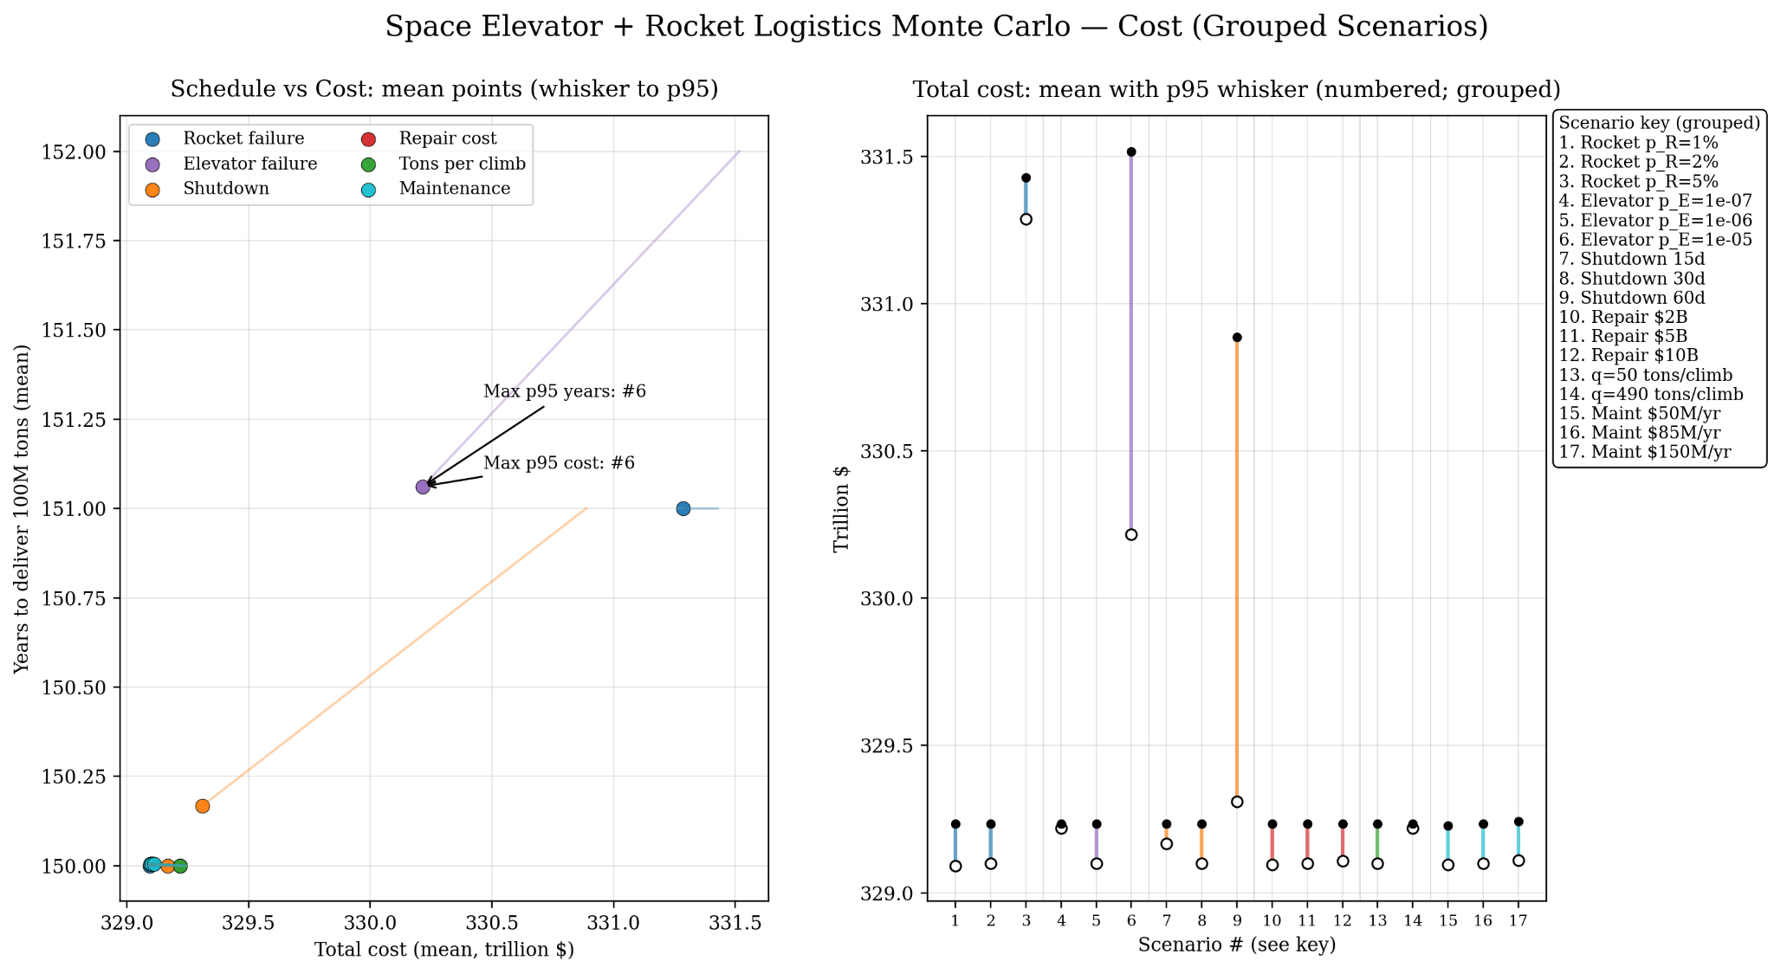
Stochastic Disruptions
Conclusions about simulations of failures

Slide 19
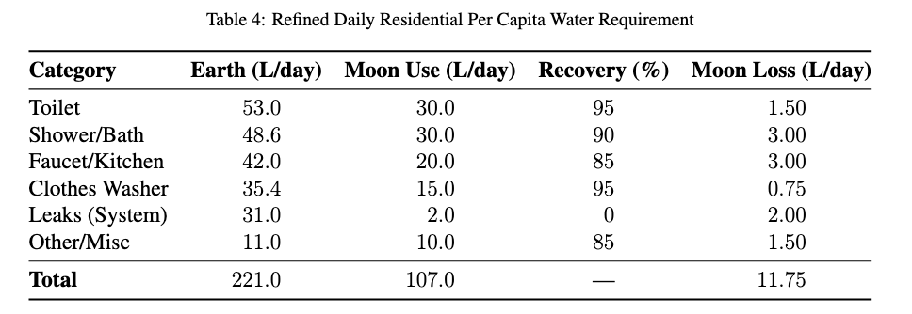
Colony Water Sustainment Analysis
Water usage are mainly divided into
a) Residential Usage b) Agricultural Usage c) Industrial Usage
Residential Water Need
On Earth, average per person per day is 221L[3]; on Moon, we expect it to be much smaller and recycling rate much higher.
NASA concludes 4 astronauts use 41L of water per day, with water reuse rate of 98%[4, 5].
Estimated residential water need per year is ~4.29 × 10⁸L.

Slide 20
Colony Water Sustainment Analysis
Agricultural Water Need
Energy requirement per capita: 2200 kcal/day
Assuming food energy density = 1.5 kcal/g, the required daily edible biomass per capita ~1.47kg/day, and 5.37 * 10⁷ kg/year for 100,000 people.
Assuming productivity of 20-40 g/m²d, at least 5 km² of cultivation area is required [8].
Assumeing hydroponic systems reduces water use by 90% [7] and cooling coils captures evapotranspiration [8], we estimate a 2% loss of water due to metabolic bonding and leakages.
Scaled from NASA’s BPC experimental data [8], 1 L/m²/day is needed across 5 km². Total water use: 5*10⁶ L/day.
2% unrecoverable loss → 3.65 × 10⁷ L of water supplement annually.

Slide 21
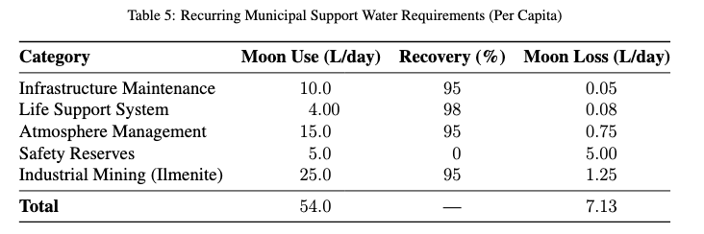
Colony Water Sustainment Analysis
Industrial Water Need
We separate into four categories:
Infrastructure: technical needs like cooling, dust mitigation, and chemical processing.
Life support system: primarily accounts for the system losses and draws in recycling.
Atmosphere management: humidity control and air composition adjustment needs.
Safety reserves: a safety buffer of potable and fire-suppression water.
We also consider the possibility of lunar mining.
Moon is rich on ilmenite (FeTiO₃): 31.6% titanium, 36.8% iron and oxygen [9], and has O₂ as a byproduct [10]. This relies on efficient reagent recovery (Cl₂, H₂, Ca, C) [10]
This is much more economic than transporting from Earth.
7.13 L/day/person → ~2.60 * 10⁸ /year.

Slide 22
Colony Water Sustainment Analysis
Water Needs Summary
The total annual water needs is 4.29 × 10⁸ L + 3.65 × 10⁷ L + 2.60 × 10⁸ L = 7.26 × 10⁸ L/year
This means a monthly goal of 60500 metric tons, at full capacity of both rockets and climbers (150 rocket launches, 929 climbers).

Slide 23


Environmental Impact
Biodiversity Risk
Over 60% of rocket launch sites are situated within or adjacent to protected areas.
Biodiversity risk is calculated using intersection with protected areas listed in WDPA (World Database on Protected Areas) times species richness averaged by IUCN.
The metric is normalized
We select three space elevator sites and normalize them with the rocket launch sites:
Marsabit Desert, Kenya (2.704◦N, 37.263◦E)
Galapagos Highlands (0.633◦S, 90.367◦W)
Padang, Indonesia (0.949◦S, 100.354◦E)
All less than 3◦ to the equator, to avoid tether stress and ensure structural integrity, which would be disastrous for a 100,000km space elevator. Inland locations are prioritized and relative lower biodiversity were targeted (especially for equatorial latitudes).

Slide 24
Environmental Impact
Ozone Risk
Ozone risk become more prominent when considering the frequency of rocket launches in this hypothetical scenario.
Black Carbon (BC) emissions are directly injected into the stratosphere with a residence of up to 6 years [11]. BC heats up atmosphere, thereby causing ozone loss.
There is no statistically significant evidence that the ozone hole is recovering (increase of 0.3%/decade with an uncertainty of at least ±0.3%/decade in 60◦S-60◦N over 1996-2020), but in current levels of emissions it is not getting worse [13].
Falcon Heavy uses RP-1/LOX fuel, which is already one of the cleanest rocket fuel while ensuring enough thrust. Emits 13.15 tons of BC in stratosphere per launch [12].

Slide 25
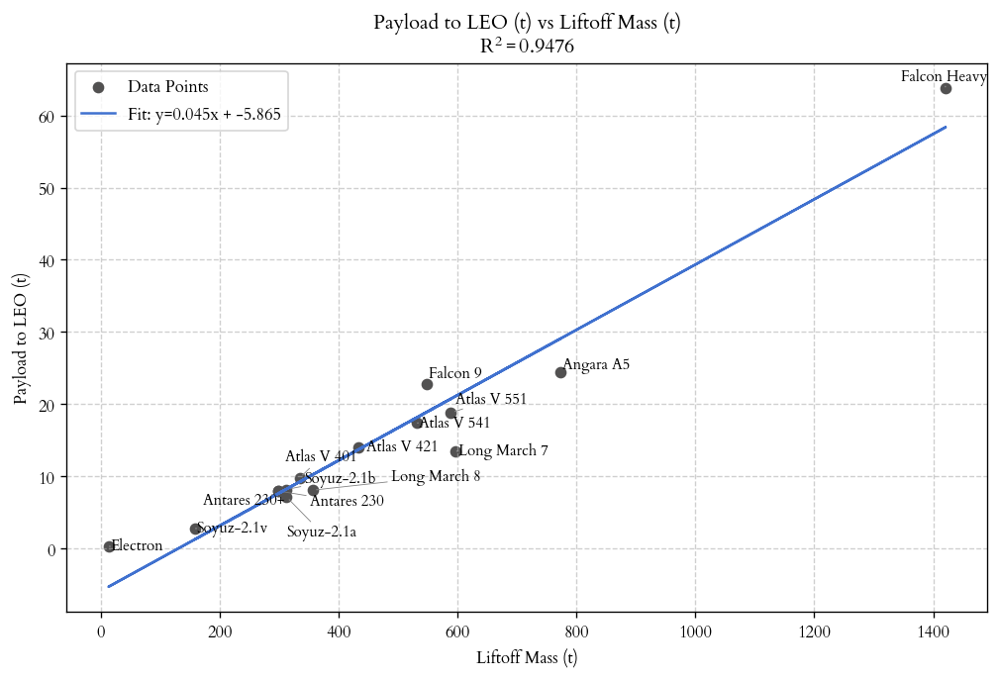
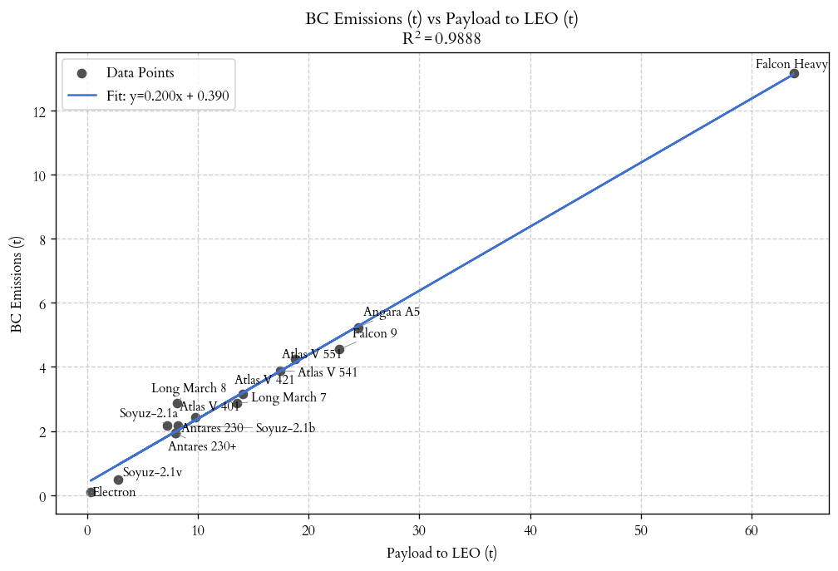
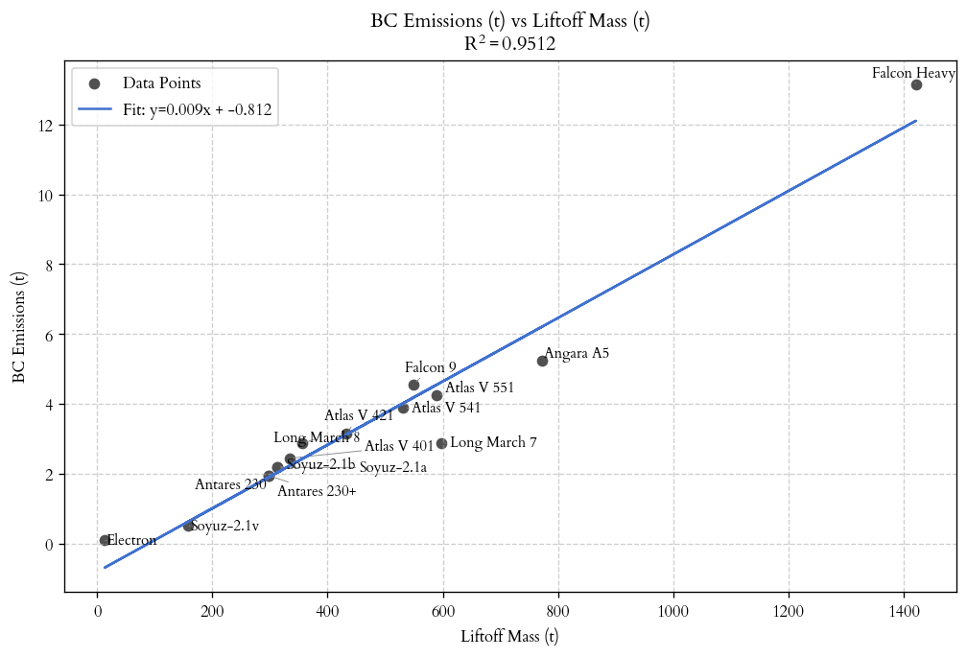
Environmental Impact
Ozone Risk
Found that BC emissions and payload has a near perfect-linear relationship.

Slide 26
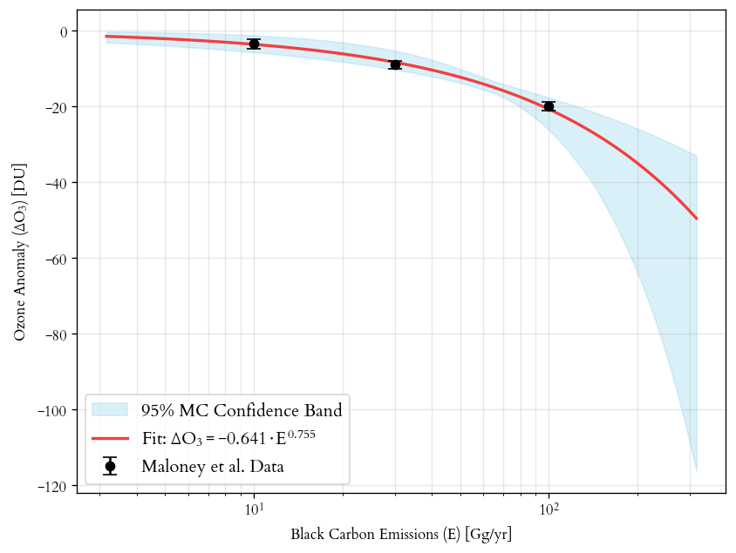

Environmental Impact
Ozone Risk
Dobson Unit (DU) is used to measure the thickness of the ozone layer.
According to Maloney’s simulation [4], a 10Gg of BC emissions will result in a statistically significant -3.5DU reduction annually; 30Gg -9.05DU; 100 Gg -20DU.
Confidence band is calculated by repeatedly sampling the three ozone anomalies assuming normal distribution and fitting the log-log power law, and take the 2.5% and 97.5% percentile for each point.

Slide 27

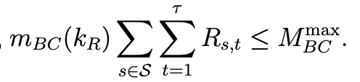




Environmental Impact
Ozone Risk
Constraining ozone while minimizing biodiversity
Constraining biodiversity while minimizing ozone
Minimizing ozone loss is same as minimizing rocket launches.

Slide 28
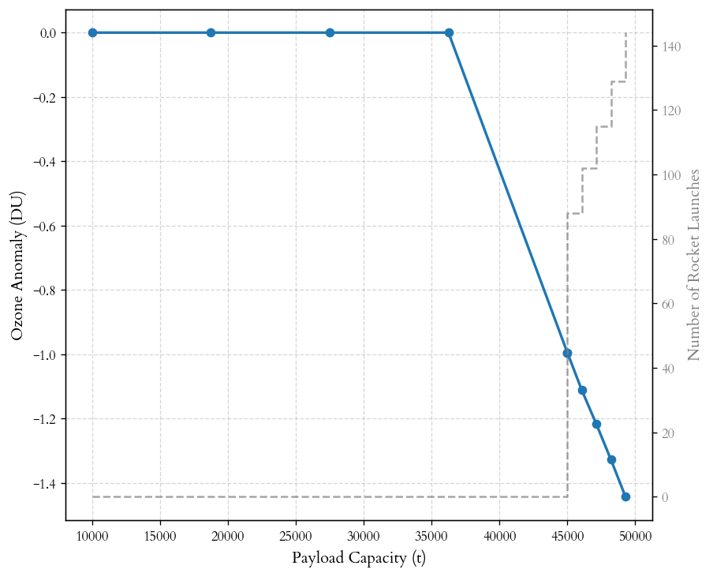
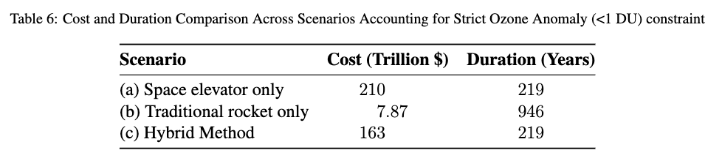
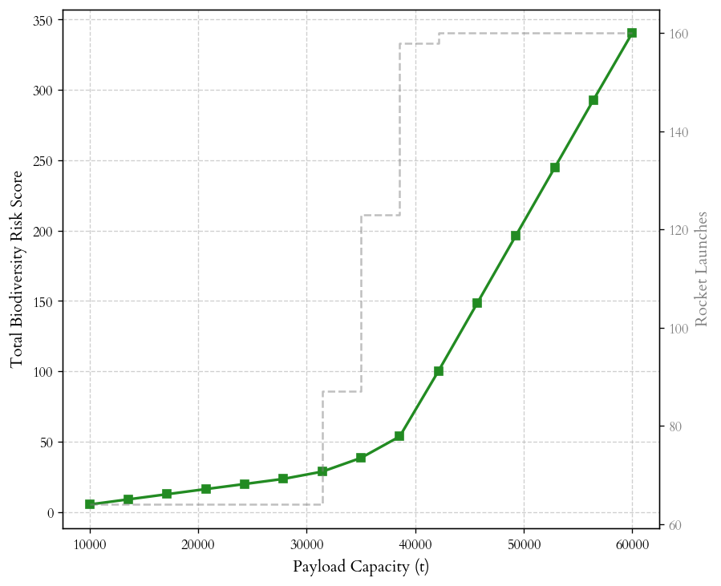
Environmental Impact
Results Summary
Assuming a constraint of DU_{max} = -1, we set a goal of payload 38,000 tons. Minimizing the biodiversity risk gives the above cost for space elevator, traditional rocket, and hybrid method.

Slide 29
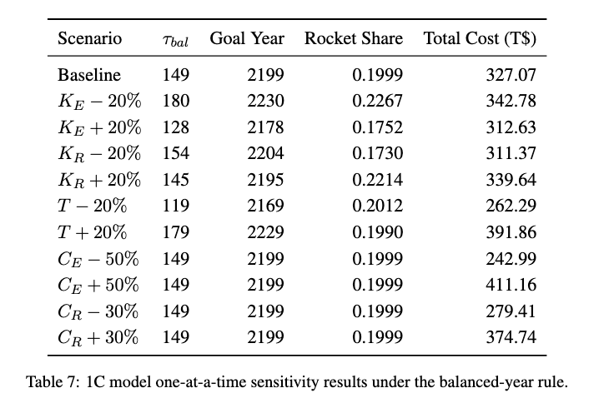
Sensitivity Analysis
Systemic Capacity Demand

Slide 30
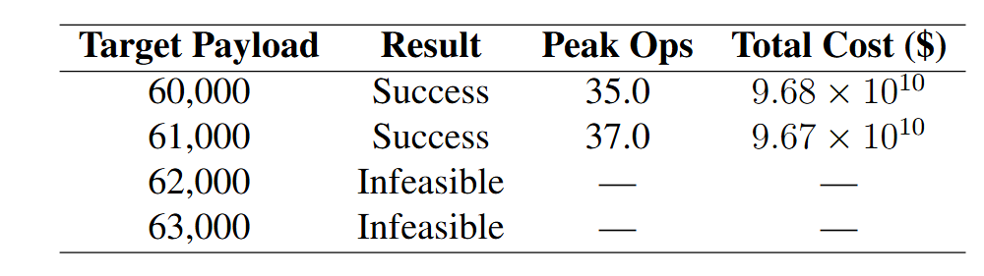
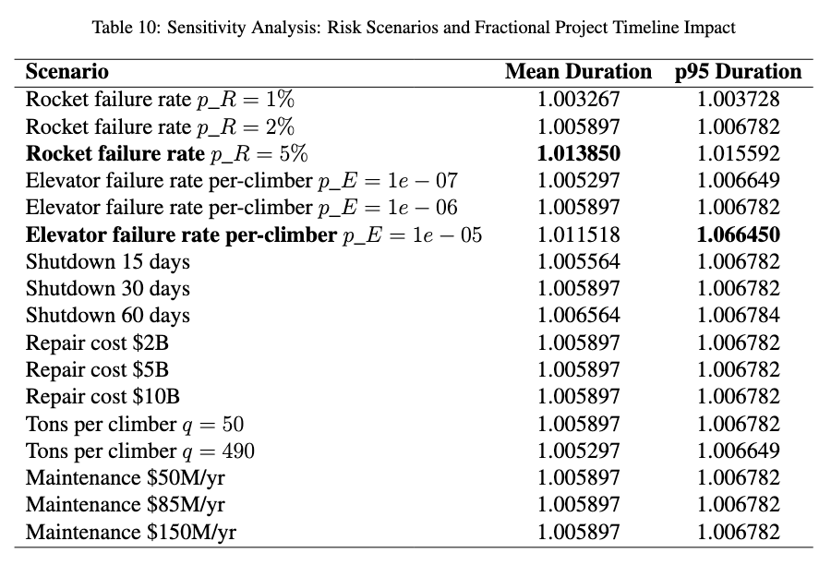
Sensitivity Analysis
Throughput Vulnerability (Water Demand)
Hybrid model’s max payload capacity: 61,000 Mt/month
Recall: a monthly water requirement of 60,500 Mt for the operational colony.
Rocket failure rate increasing to 5% delays mean delivery by 5 days/yr
Elevator failure rate increasing to 1/10^5 climbers delays mean delivery by 24 days/yr

Slide 31
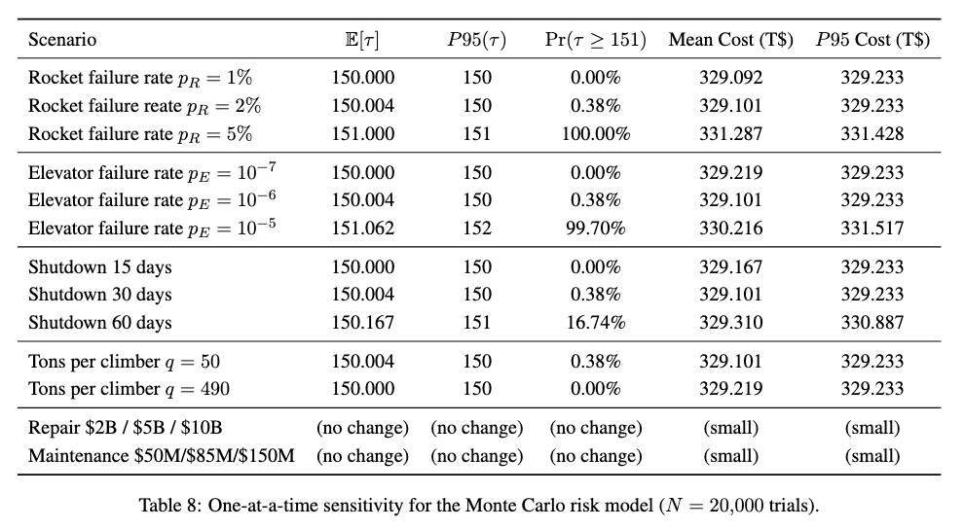
Sensitivity Analysis
Operational Resilience
Assuming a constraint of DU_{max} = -1, we

Slide 32
Sensitivity Analysis
Notable Results
Completion time is most sensitive to rocket reliability and elevator availability.
Rocket failure rate from 2% to 5% -> 150 years stop being achievable.
Elevator failure rate 10⁻⁶ to 10⁻⁵ -> over 149 years, increased expected failures from 1.6 to 15.2
Increasing downtime from 30 to 60 days makes 16.7% runs 151 years not achievable.
Water supply is extremely fragile; deliveries can delay from 5 days-1 month.
Repair and maintenance does not change schedule.
Tons/climber does change schedule as there are less climbers overall prone to failure risks.

Slide 33
Strengths and Limitations
Strengths
Key modeling and results are driven by physical throughput and capacity constraints.
Monte Carlo results distinguish schedule risk from cost risk
Environmental impacts are treated in two dimensions (biodiversity and ozone)
Limitations
No lunar LSRU (in-situ resource utilization)
Time-invariant capacities and unit costs (no economies of scale or cost evolution)
No dynamic adaption (different launching sites or infrastructure assumptions)
Ozone dynamics does not take into account seasonality, meteorology, atmospheric transport

Slide 34
Conclusions
Conclusion
Hybrid Strategy is better.
Long-term maintenance almost impossible: 100,000 colony requires 726,000 tons of water annually, 60,500 tons per month.
Does not satisfy the suggested limits on biodiversity risk + ozone
Very susceptible to any sort of failures, rocket or climbers.
Future Improvement
Use higher-resolution, site-specific data
Adaptive decisions: capacity expansion and contingency policies (what to do if failure)
Incorporate ISRU
More complete atmospheric model rather than ozone approximation
Consider more environmental risks.

Slide 35
References
[1] International Space Elevator Consortium (ISEC). Space elevator faq. https://www.isec.org/faq
[2] Stephen Cohen and A. Misra. The effect of climber transit on the space elevator dynamics. Acta Astronautica - ACTA ASTRONAUT, 64:538–553, 03 2009
[3]Peter W. Mayer. Water research foundation study documents water conservation potential and more efficiency in households. Journal AWWA, 108(10):31–40, 2016.
[4] Molly S. Anderson, Michael K. Ewert, and John F. Keener. Life support baseline values and assumptions document. Technical Publication NASA/TP-2015-218570/REV1, NASA Johnson Space Center, Houston, TX, 2018. JSC-E-DAA-TN51698.
[5] Melissa L. Gaskill. NASA achieves water recovery milestone on international space station. International Space Station Research Communications Team.
[6] U.S. Department of Agriculture and U.S. Department of Health and Human Services. Dietary guidelines for americans, 2020-2025. Technical Report, U.S. Government Printing Office, Washington, DC, 2020.
[7] Ganapathy Rajaseger, Kit Lun Chan, Kay Yee Tan, Shan Ramasamy, Mar Cho Khin, Anburaj Amaladoss, and Patel Kadamb Haribhai. Hydroponics: current trends in sustainable crop production. Bioinformation, 19(9):925–938, Sep 2023
[8] R.M. Wheeler, C.L. Mackowiak, G.W. Stutte, J.C. Sager, N.C. Yorio, L.M. Ruffe, R.E. Fort-son, T.W. Dreschel, W.M. Knott, and K.A. Corey. Nasa’s biomass production chamber: A testbed for bioregenerative life support studies. Advances in Space Research, 18(4):215–224, 1996. Natural and Artificial.
[9] David S. McKay and Richard J. Williams. A geologic assessment of potential lunar ores. In Gerard K. O’Neill, Brian O’Leary, and John Billingham, editors, Space Resources and Space Settlements, number NASA-SP-428 in NASA Special Publication, pages 243–255, Moffett Field, CA, 1979. NASA Ames Research Center. Document ID: 19790024068.
[10] D. Bhogeswara Rao, U. V. Choudary, T. E. Erstfeld, R. J. Williams, and Y. A. Chang. Extraction processes for the production of aluminum, titanium, iron, magnesium, and oxygen from nonterrestrial sources. In Gerard K. O’Neill, Brian O’Leary, and John Billingham, editors, Space Resources and Space Settlements, number NASA-SP-428 in NASA Special Publication, pages 257–274, Washington, DC, 1979. National Aeronautics and Space Administration. Document ID: 19790024069
[11] Christopher M. Maloney, Robert W. Portmann, Martin N. Ross, and Karen H. Rosenlof. The climate and ozone impacts of black carbon emissions from global rocket launches. Journal of Geophysical Research: Atmospheres, 127(12), 2022.
[12] Tyler F. M. Brown, Michele T. Bannister, Laura E. Revell, Timofei Sukhodolov, and Eugene Rozanov. Worldwide rocket launch emissions 2019: An inventory for use in global models. Earth and Space Science, 11(10), 2024
[13] World Meteorological Organization, United Nations Environment Programme, National Oceanic and Atmospheric Administration, National Aeronautics and Space Administration, & European Commission. (2023). Scientific assessment of ozone depletion: 2022 (GAW Report No. 278). World Meteorological Organization; United Nations Environment Programme. https://library.wmo.int/idurl/4/58360.

Slide 36
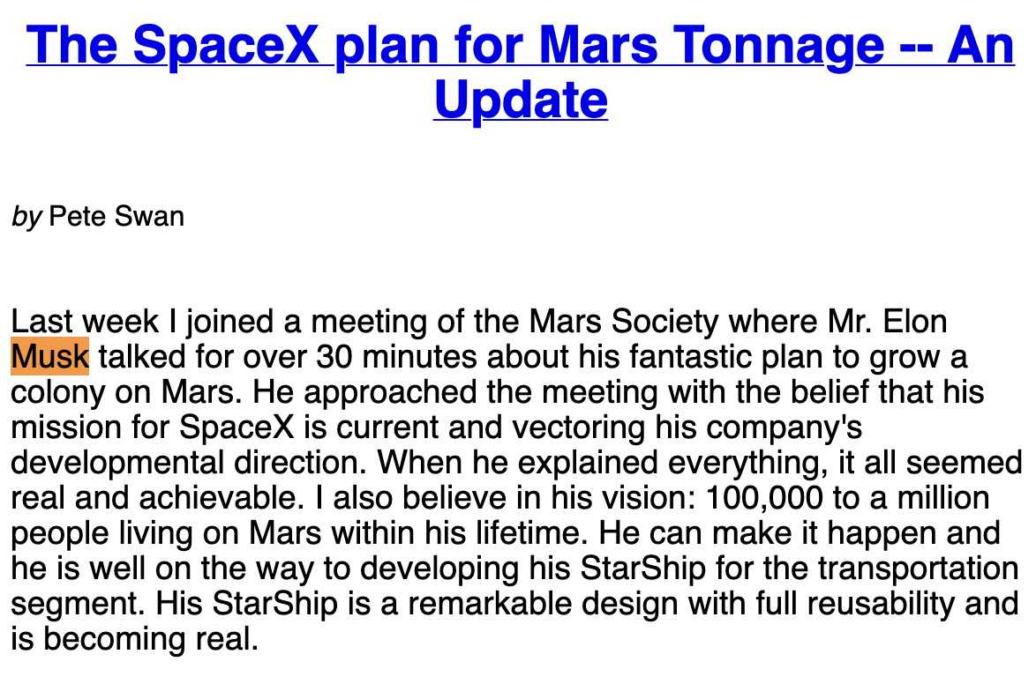
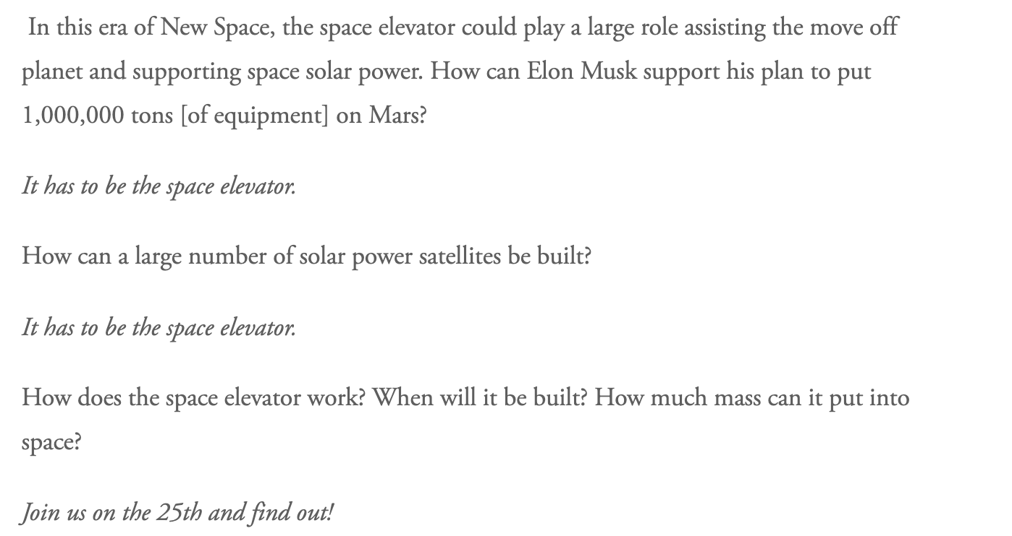
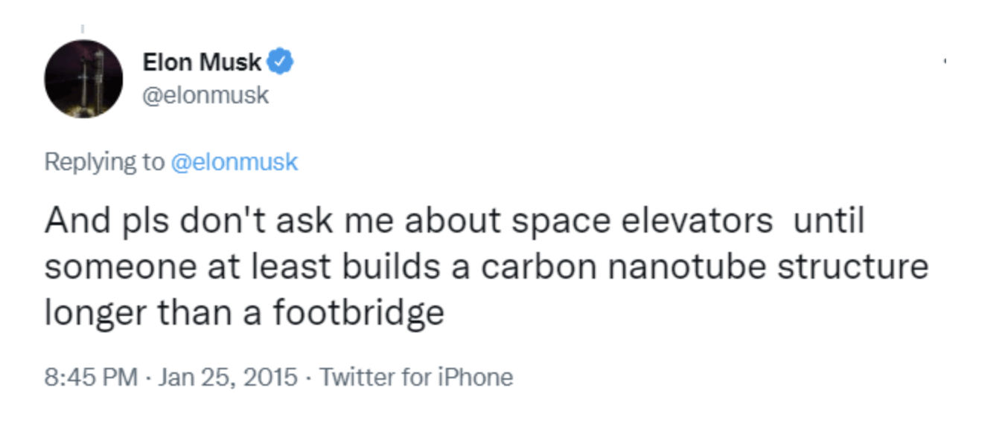
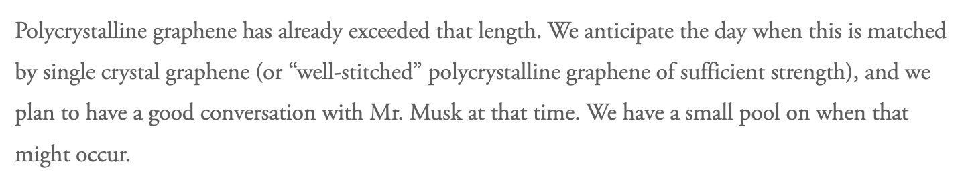
Appendix A.

